Slide 1
FEATURE EXTRACTION AND PRICE PREDICTION FOR MOBILE PHONES
Data-Driven Mobile Pricing Using Machine Learning
Presented By: Sarthak Sandhan
University Name: Sanjivani University
Date: 25 August 2026
Project Domain: Data Science | Machine Learning | Business Analytics

Slide 2




Business Problem & Project Objective
Business Scenario
Business Problem
Project Objective
A leading mobile-phone organization needs a data-driven pricing strategy that explains price variation across hardware and technical features.
Identify which product features most strongly influence price and estimate expected price to support pricing and marketing decisions.
Identify high-impact mobile features and build a reliable predictive model to estimate mobile-phone prices.
Mobile Features
Feature Analysis
Price Prediction
Business Decision
End-to-end flow: convert specs into actionable pricing guidance for product and marketing teams.

Slide 3
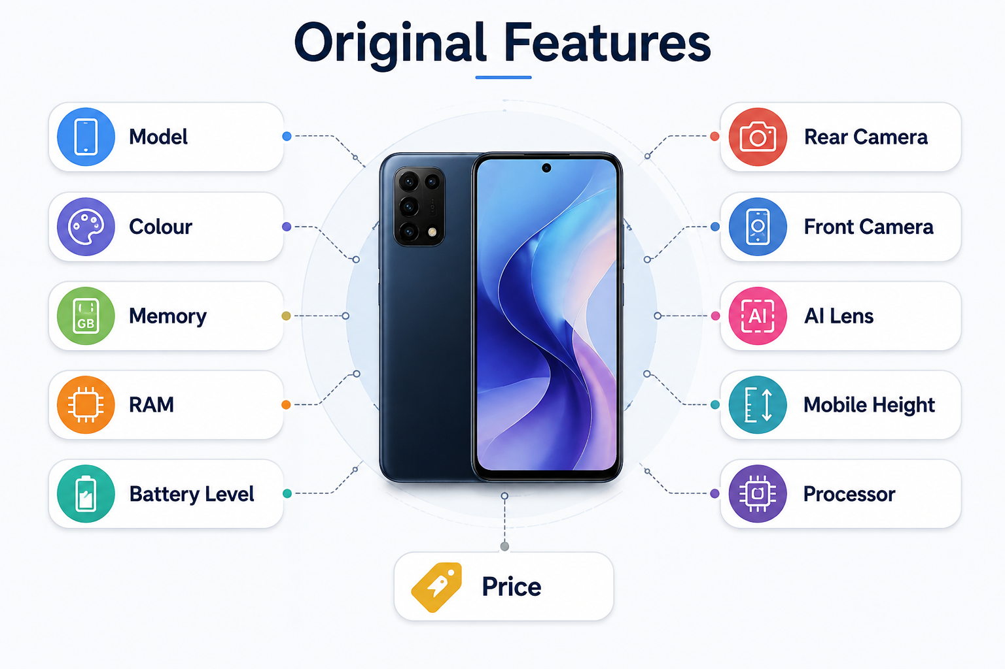
Dataset Overview
Original Features
Model
Colour
Memory
RAM
Battery Level
Rear Camera
Front Camera
AI Lens
Mobile Height
Processor
Price
Total Records
Original Columns
Dataset Domain
541
11
Mobile Phones
Target Variable
Price

Slide 4
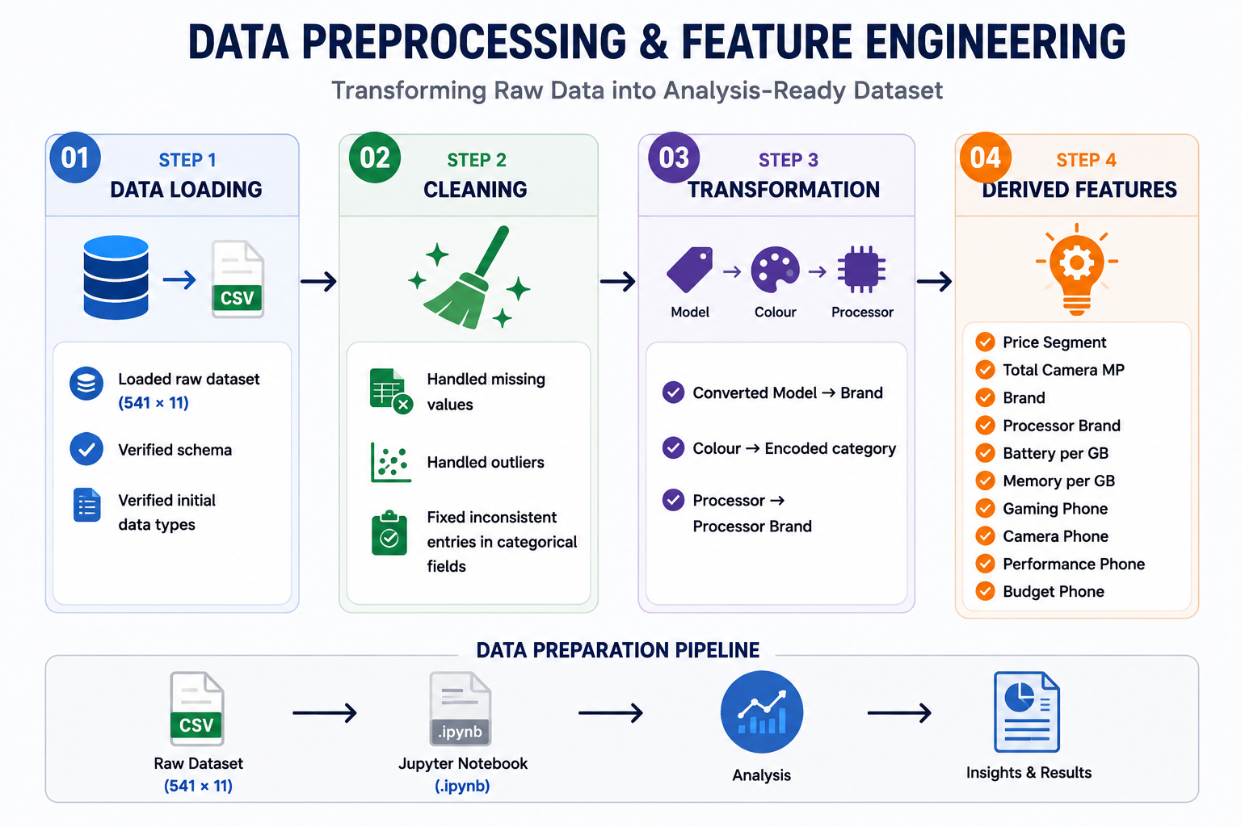

Data Preprocessing & Feature Engineering
01
Step 1 — Data Loading
Loaded raw dataset (541 × 12). Verified schema and initial data types.
02
Step 2 — Cleaning
Handled missing values, outliers, and inconsistent entries in categorical fields.
03
Step 3 — Transformation
Converted Model → Brand; Colour → encoded category; Processor → Processor Brand.
04
Step 4 — Derived Features
Engineered: Price Segment, Total Camera MP, Brand, Processor Brand, Battery per GB, Memory per GB, Gaming/Camera/Performance/Budget flags.
Pipeline: Raw Dataset → Cleaning → Encoding → Feature Engineering → Analysis Dataset

Slide 5
Univariate Analysis — Price & Brand
Price distribution: concentrated in lower-to-mid ranges and clearly right-skewed. Boxplot: most phones cluster at lower prices; several high-price outliers up to ~₹80,000.
Brand Counts (Top & Tail)
Key insight: realme dominates the dataset (98 records); several brands have very small representation.

Slide 6
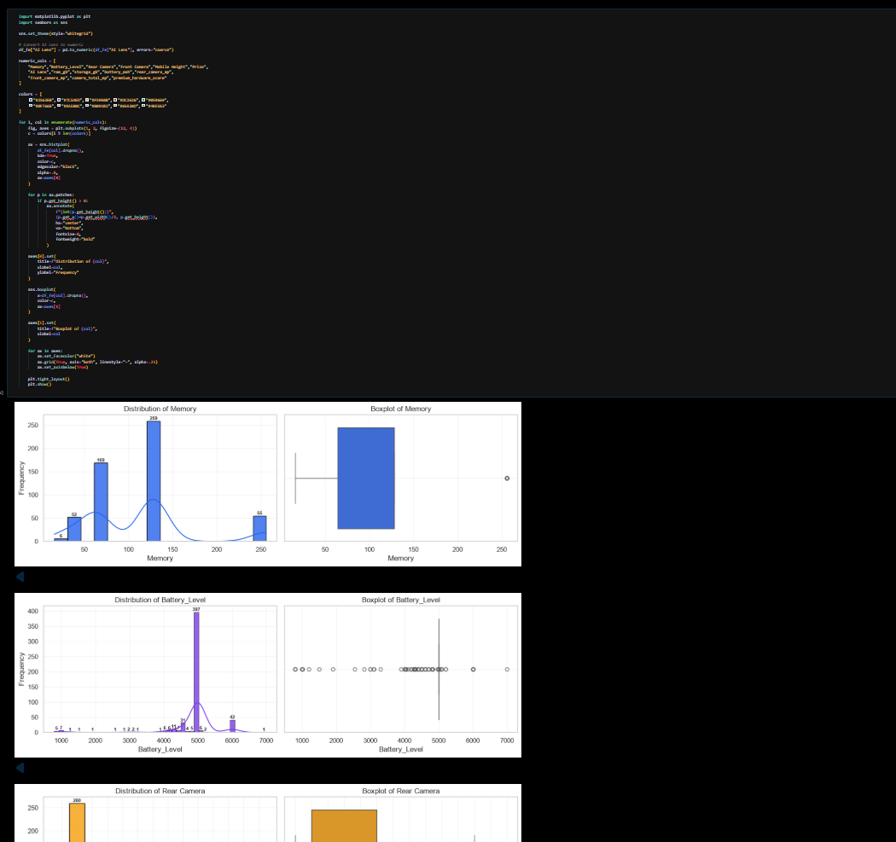

Bivariate & Multivariate Analysis
Dashboard: analyze numerical features vs Price and categorical price comparisons. (Large charts for presentation clarity.)
Numerical features analyzed: RAM, Memory, Battery Level, Mobile Height, Total Camera MP, Memory per GB, Battery per GB.
Where correlation values are required: insert actual results from notebook → [Insert Actual Correlation Result]

Slide 7


Feature Extraction & Selection
Original Features
Feature Selection
EDA & Visualization
Techniques used: correlation analysis, statistical tests, visualization, model-based importance, and dimensionality reduction where appropriate.
Most Influential Features
[Insert Final Top Features from Model]
Do not finalize ranking until model importance values are computed: placeholders used per project brief.

Slide 8
Machine Learning Model & Evaluation
Linear Regression
Baseline, interpretable model for continuous price prediction.
Evaluation Metrics
MAE — Mean Absolute Error
RMSE — Root Mean Squared Error
R² — Coefficient of Determination
Decision Tree
Captures non-linear feature interactions; easy to visualize.
Best Model: [Insert Actual Model]
MAE: [Insert Actual MAE] · RMSE: [Insert Actual RMSE] · R²: [Insert Actual R²]
Random Forest
Ensemble baseline for stability and feature importance.
Do not invent performance numbers — use actual notebook outputs.
Gradient Boosting
Often best predictive performance on tabular data.

Slide 9
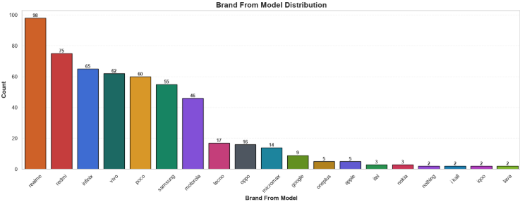
Feature Importance & Business Insights
Interpretation
High-importance features have greatest influence on predicted price; low-importance features contribute less.
Business Applications
Pricing Strategy — emphasize high-impact specs when setting price.
Product Positioning — define premium vs value models by specs.
Marketing — highlight influential features in campaigns.
Decision Support — use model predictions for price validation.
Feature importance values: [Insert Actual Importance values from model]

Slide 10
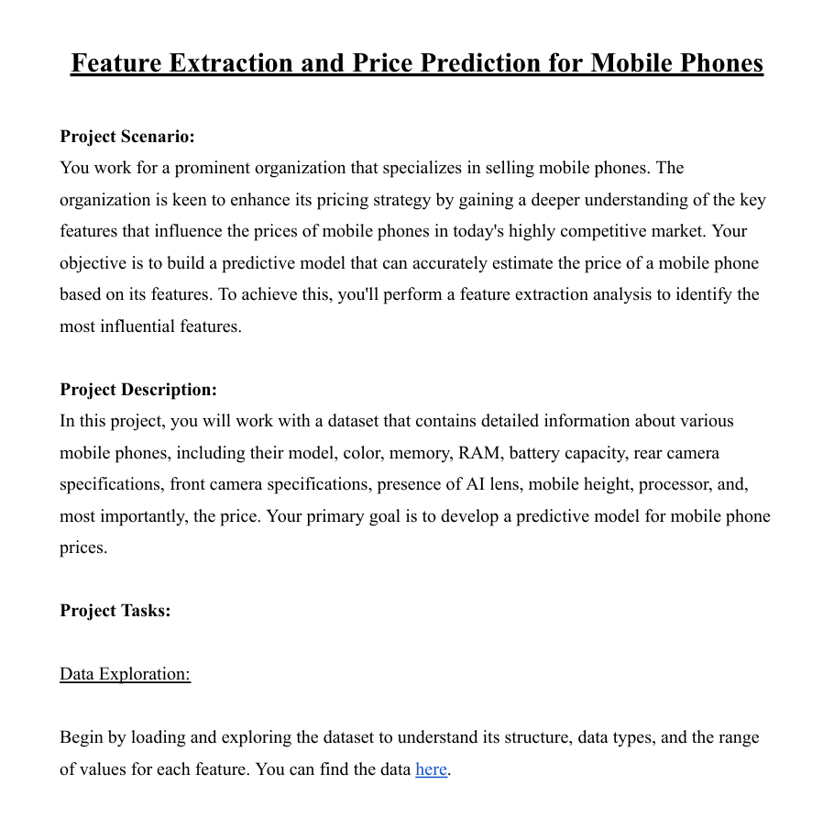
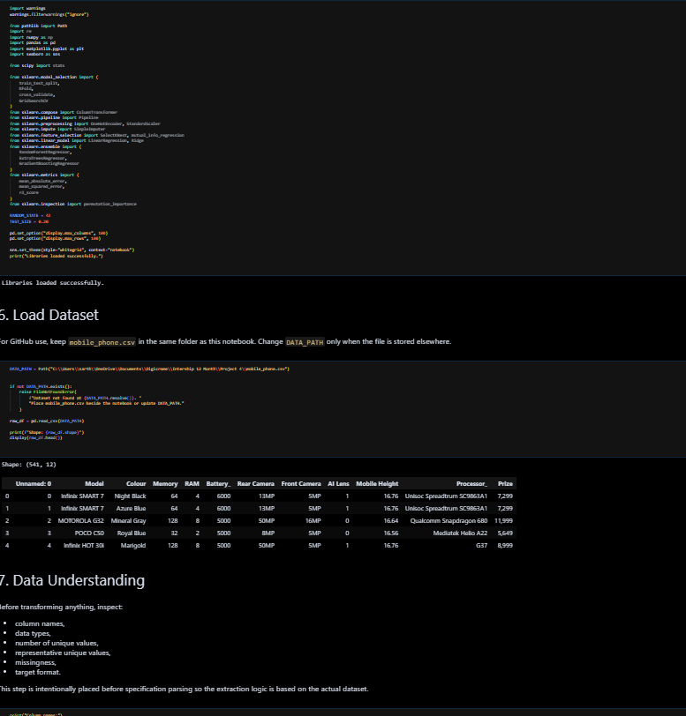
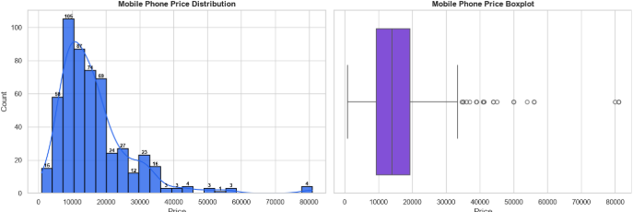
Recommendations, Conclusion & Deliverables
1
2
01 — Identify High-Impact Features
02 — Improve Pricing Decisions
Prioritize features confirmed by model importance to guide pricing and specs decisions.
Deploy the predictive model as a decision-support tool for new and existing SKUs.
3
4
03 — Strengthen Product Positioning
04 — Support Marketing
Use feature–price relationships to create meaningful market segments and SKUs.
Highlight influential specs in promotional material to increase perceived value.
Project Report / Presentation
Python Code
Visualizations & Feature Importance
Thankyou and Question

